Slide 1
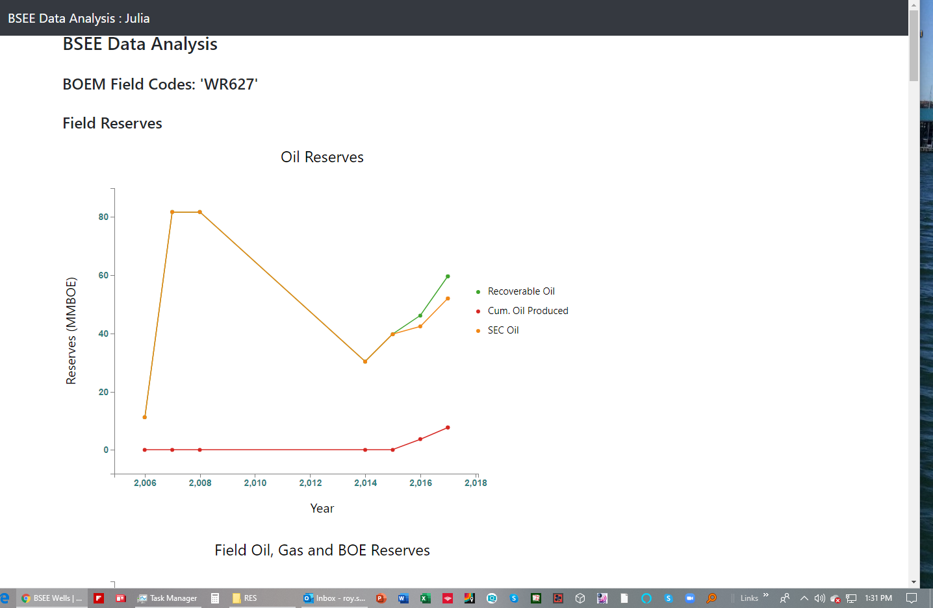
This graph seems of minimal value. Not quite sure what we are showing. Says Field Reserves. Instead of field code, should have field name.
Why is recoverable oil reserves going up and down by year?

Slide 2
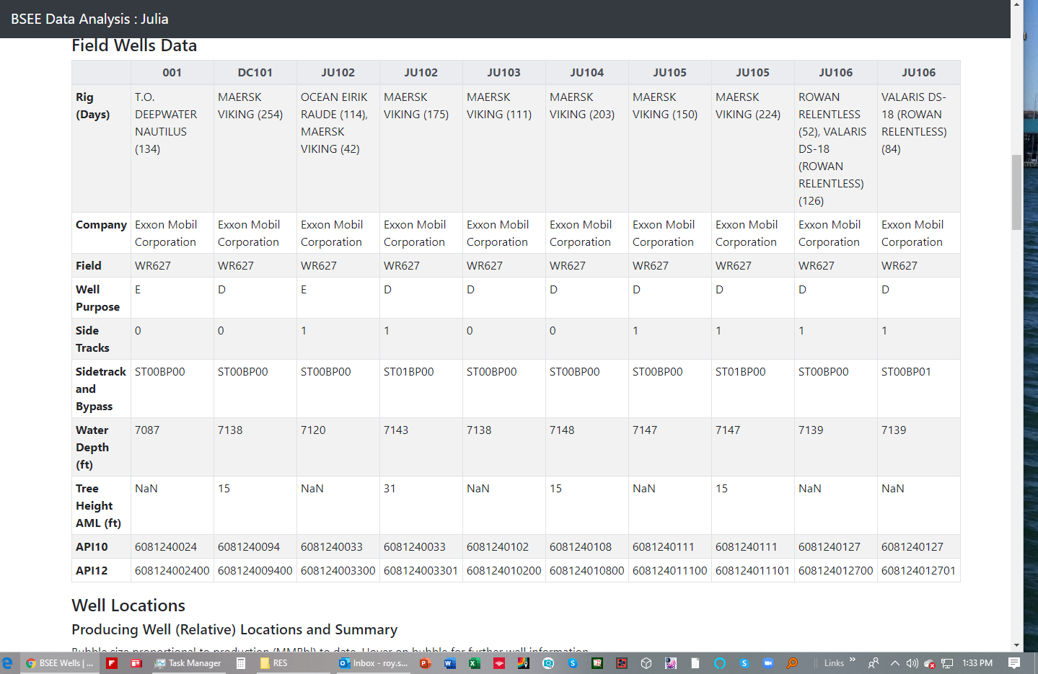
What do these numbers mean? Rig Days versus drilling and completion days? Would be better to have a separate rows in the table – Drilling Days and Completion Days
Why do we have two columns for the same well. This is confusing. Seems like each column should represent 1 well

Slide 3
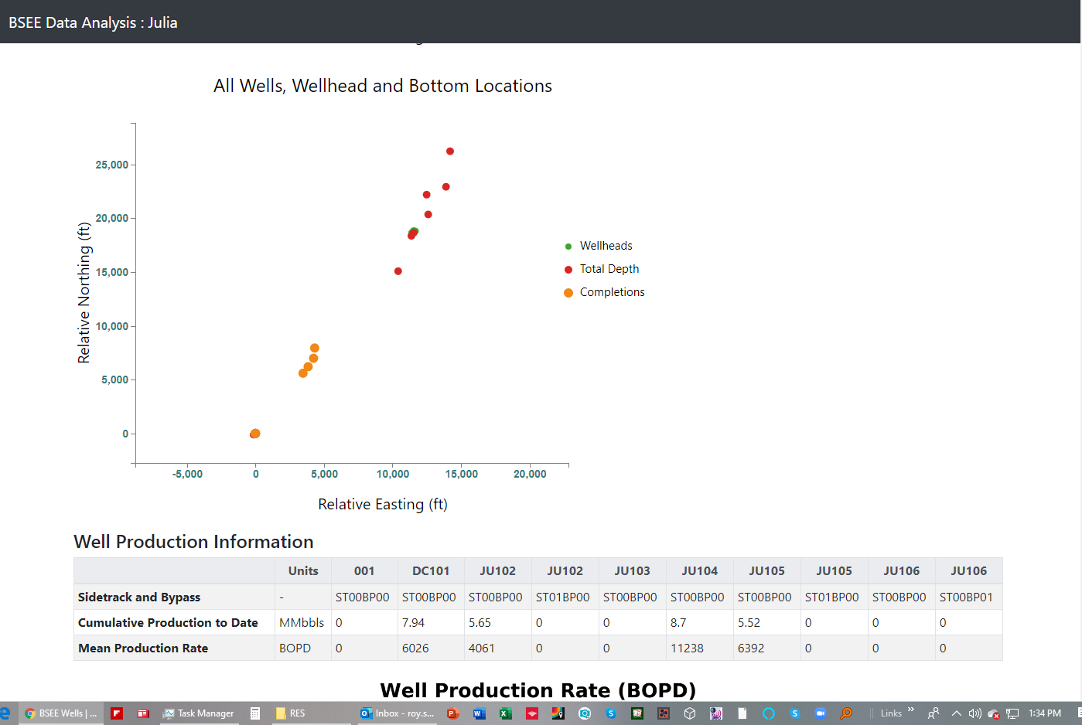
This is good. I am assuming that the orange “Completions” are the mudline location of the wellhead? And the red total depth shows the bottom hole location. I would make the orange dots green and also show wellheads that were abandoned and not completed red. Total depth can be orange.

Slide 4
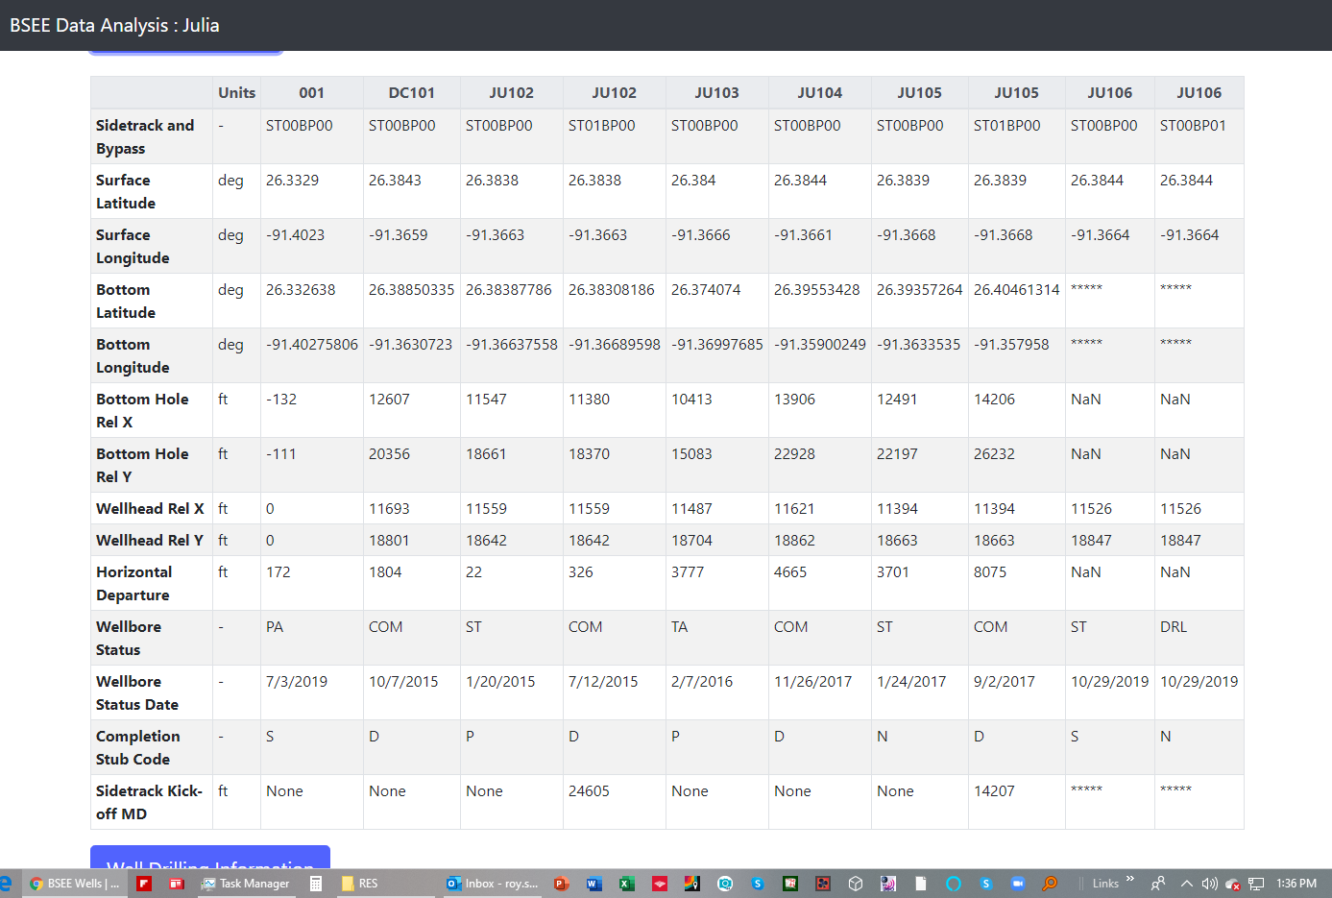
Why do these have different number of decimal places?
Started with surface hole location first, but changed to bottom hole first row?
What does completion stub code mean?
We need to work on this, we probably can find this number somewhere

Slide 5
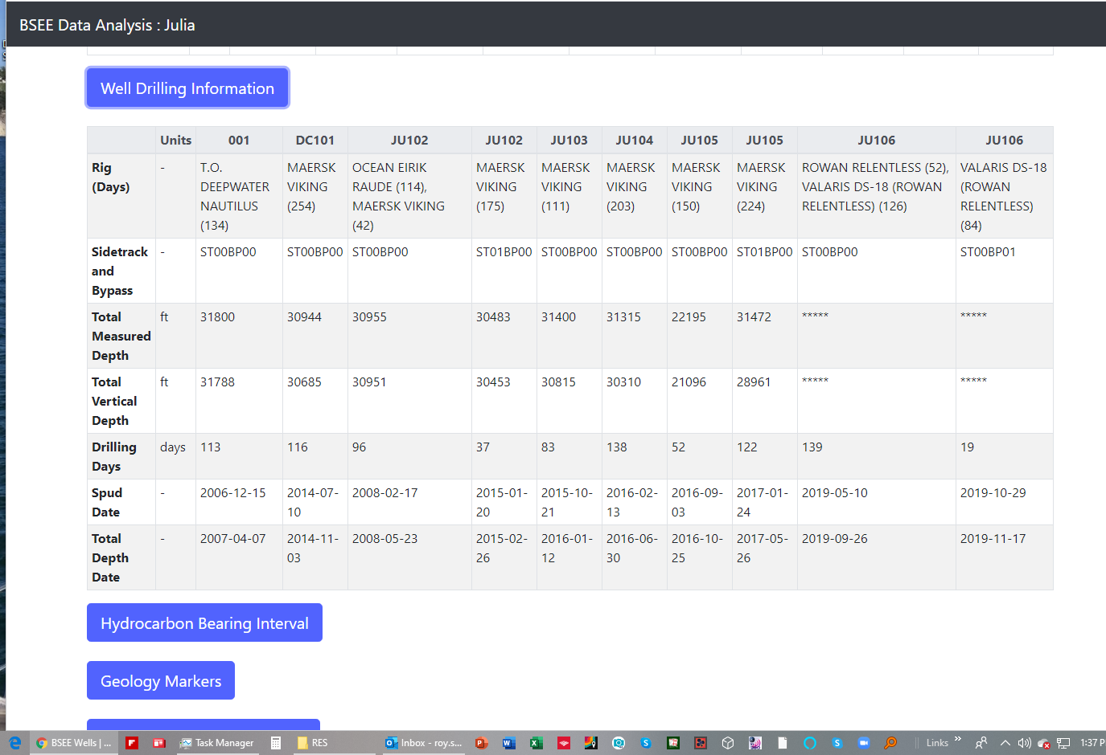
Again what are the rig days in the top row?
We have drilling days as a row, perhaps we should have 4 rows: drilling days, sidetrack days, total drilling days, completion days. This would allow us to go to 1 column per well?
Putting the Kick-off Depth in this table would make good sense.

Slide 6
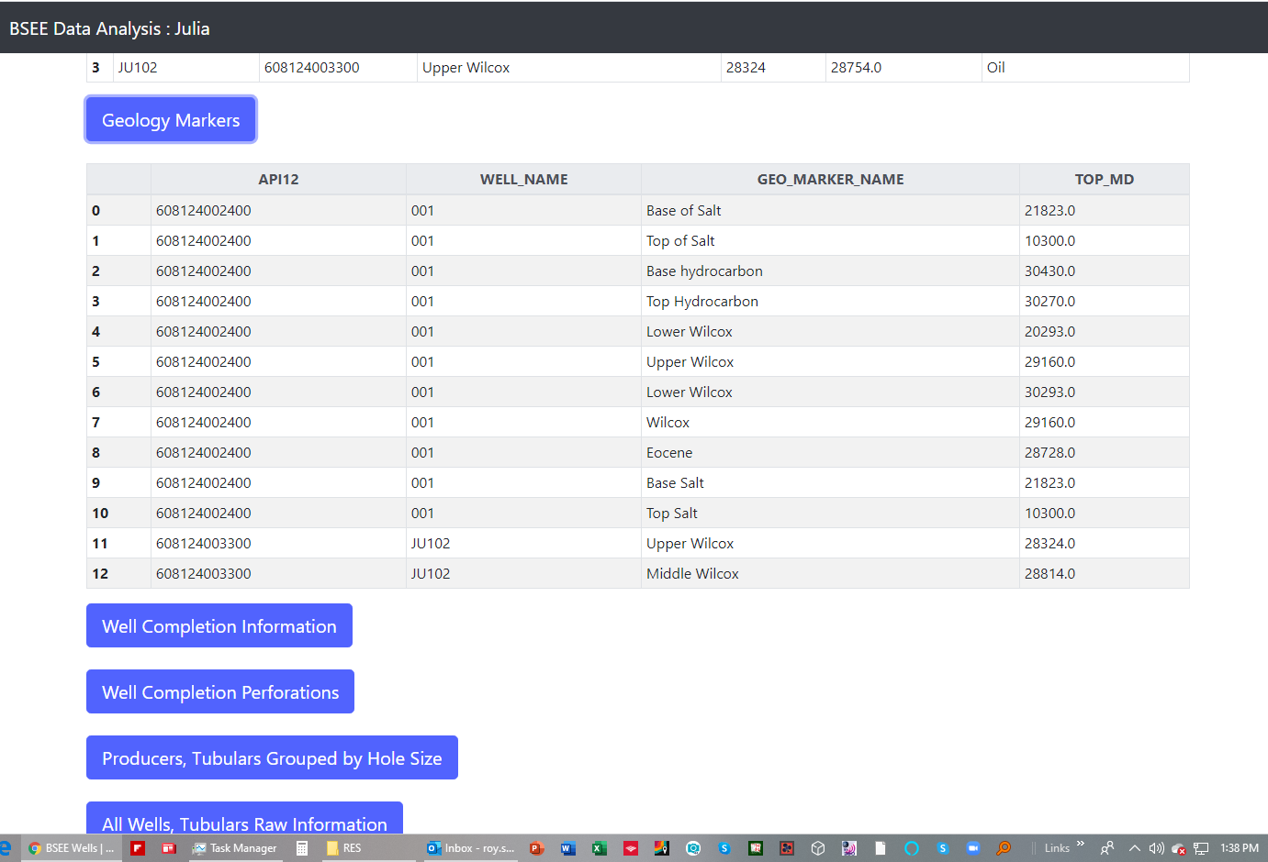
Here is where we should change the structure of the tool and interface so that the use selects the well of interest, and we get a table of the formation tops for that well. Also I believe these depths are TVD?

Slide 7
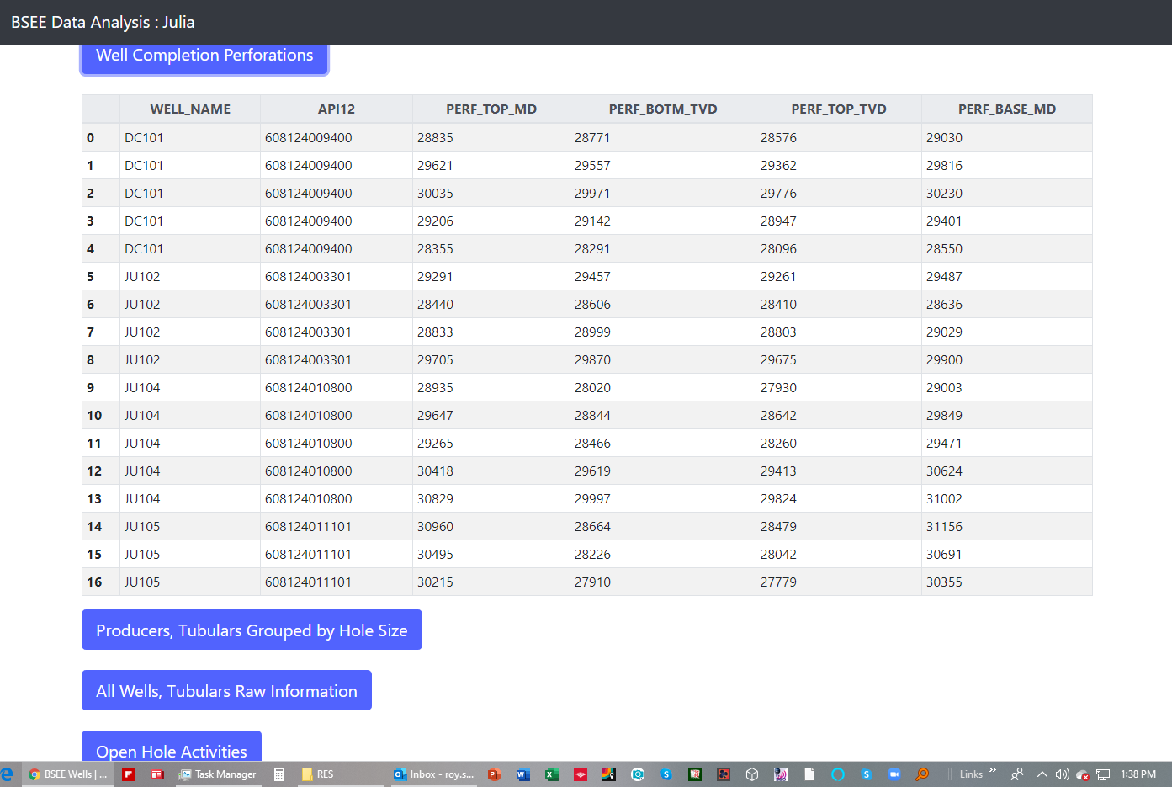
Same comment here, table would be more useful if the user selected the well, then the perforations just for that well. Don’t need API number in tables, well name is good enough

Slide 8
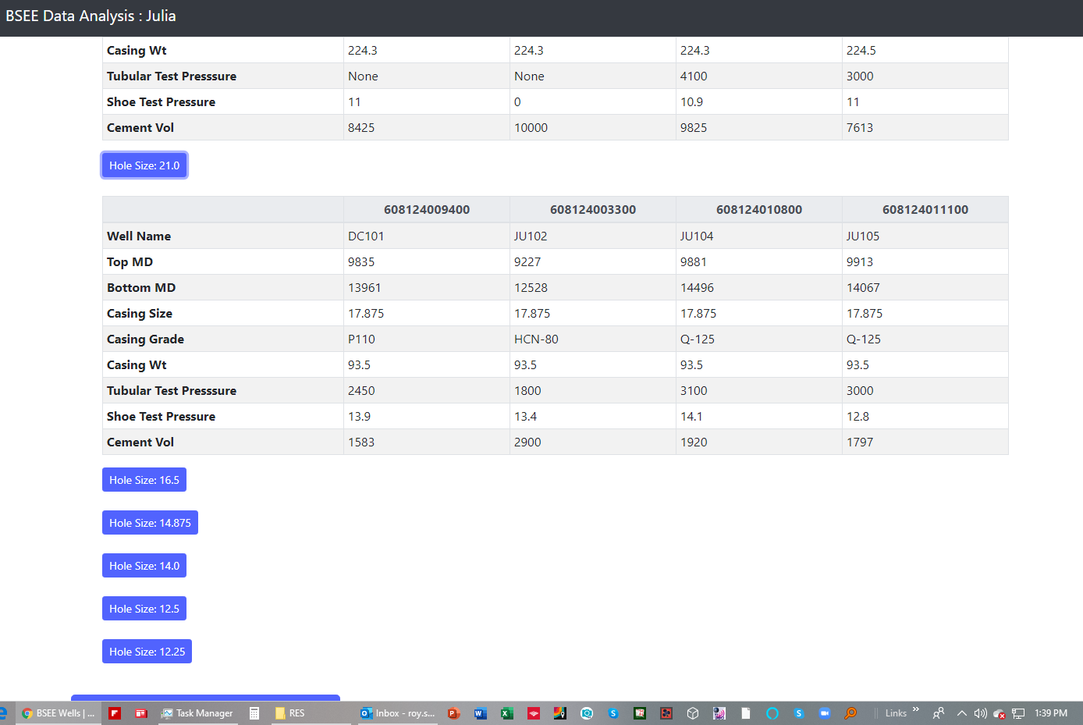
Same comment here, table would be more useful if the user selected the well, then the “Hole Sizes” just for that well are displayed showing all hole sizes for one well.

Slide 9
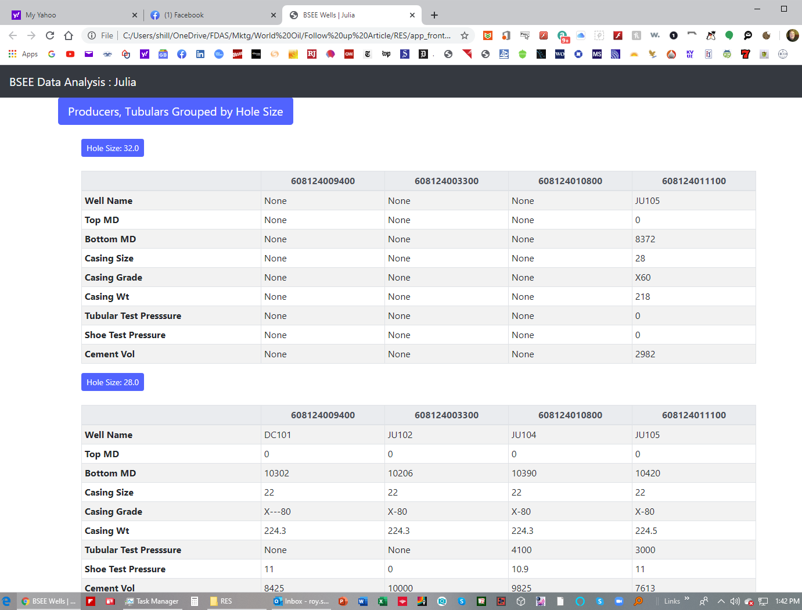
Ideally it would be most useful to have the hole size table and the casing size tables combined so we see the holes section, hole size, casing size, casing grade, weight etc in columns with the hole sections forming rows.

Slide 10
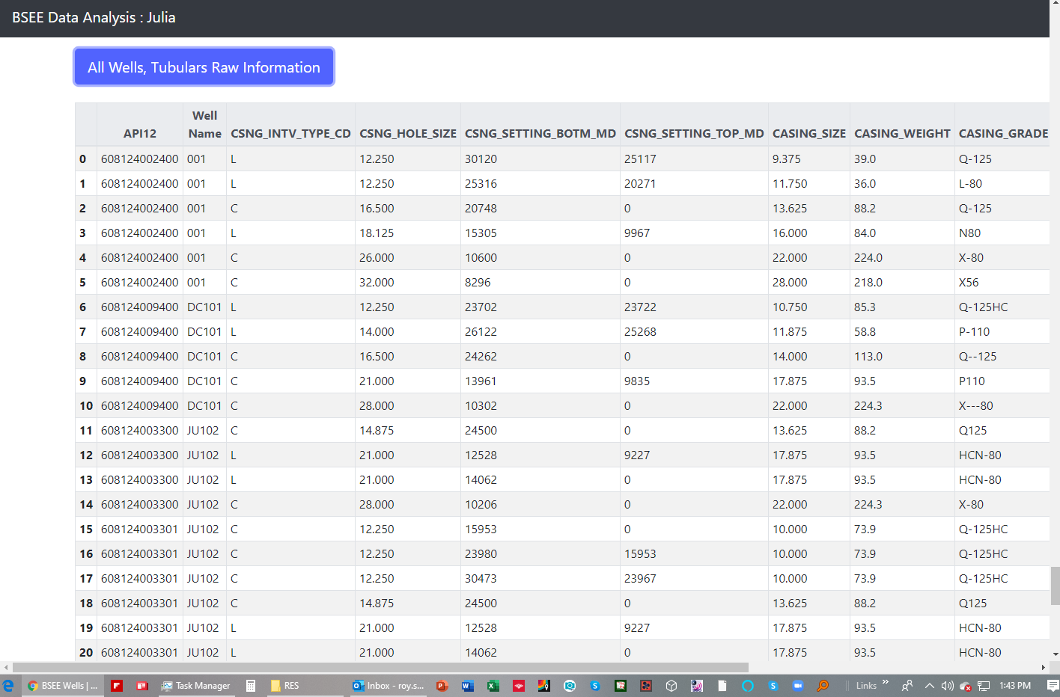
Ideally it would be most useful to have the hole size table and the casing size tables combined so we see the holes section, hole size, casing size, casing grade, weight etc in columns with the hole sections forming rows.

Slide 11
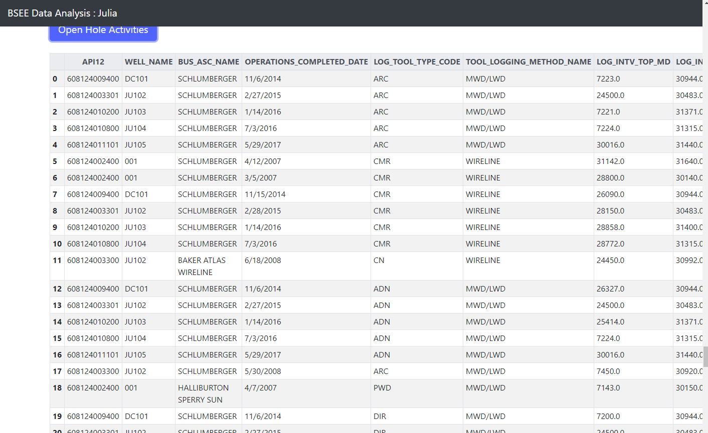
Again this would be displayed on a well by well basis after the user has selected the well.

Slide 12
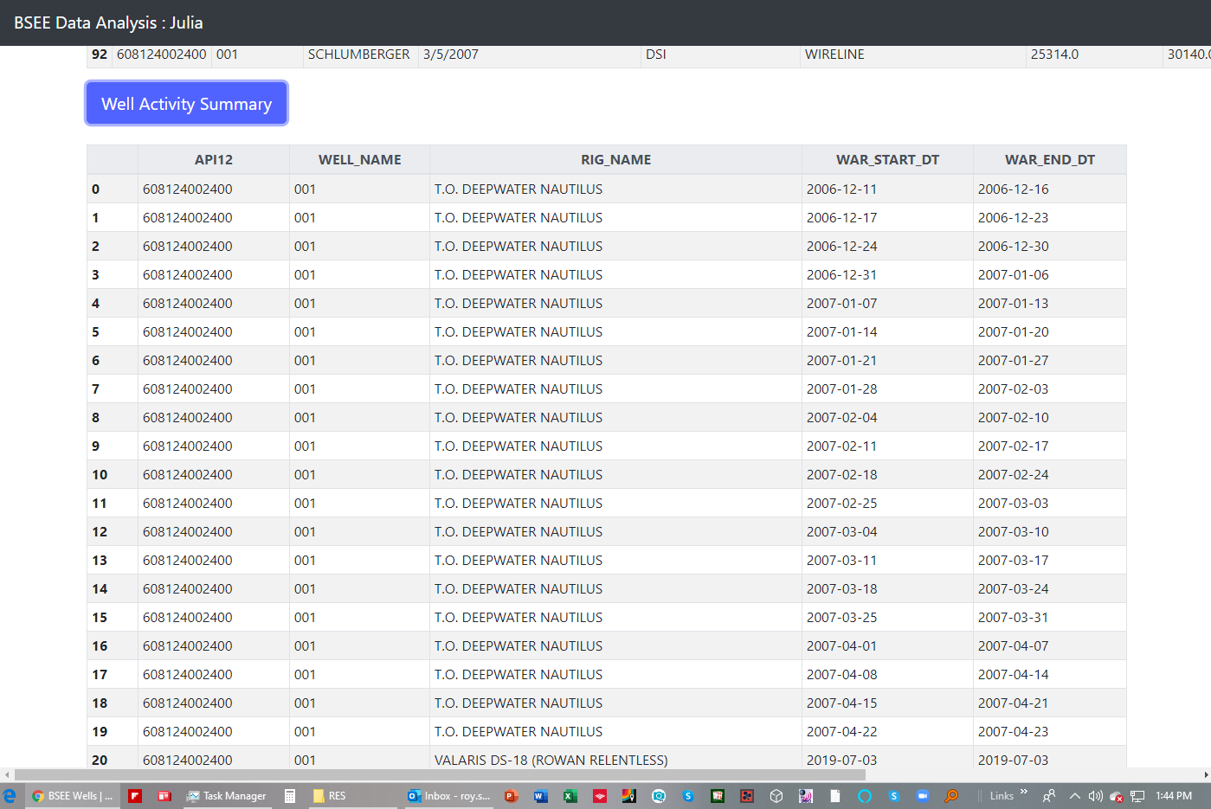
This table is not very helpful. The well activity reports should by displayed on a well by well basis. You can see from the dates here that BSEE requires the Operator to provide and weekly summary of activities. Once the user selects the well, he would then have the option of selecting the well activity reports for that well and they would be displayed with the text of weekly summaries from start to finish.

Slide 13
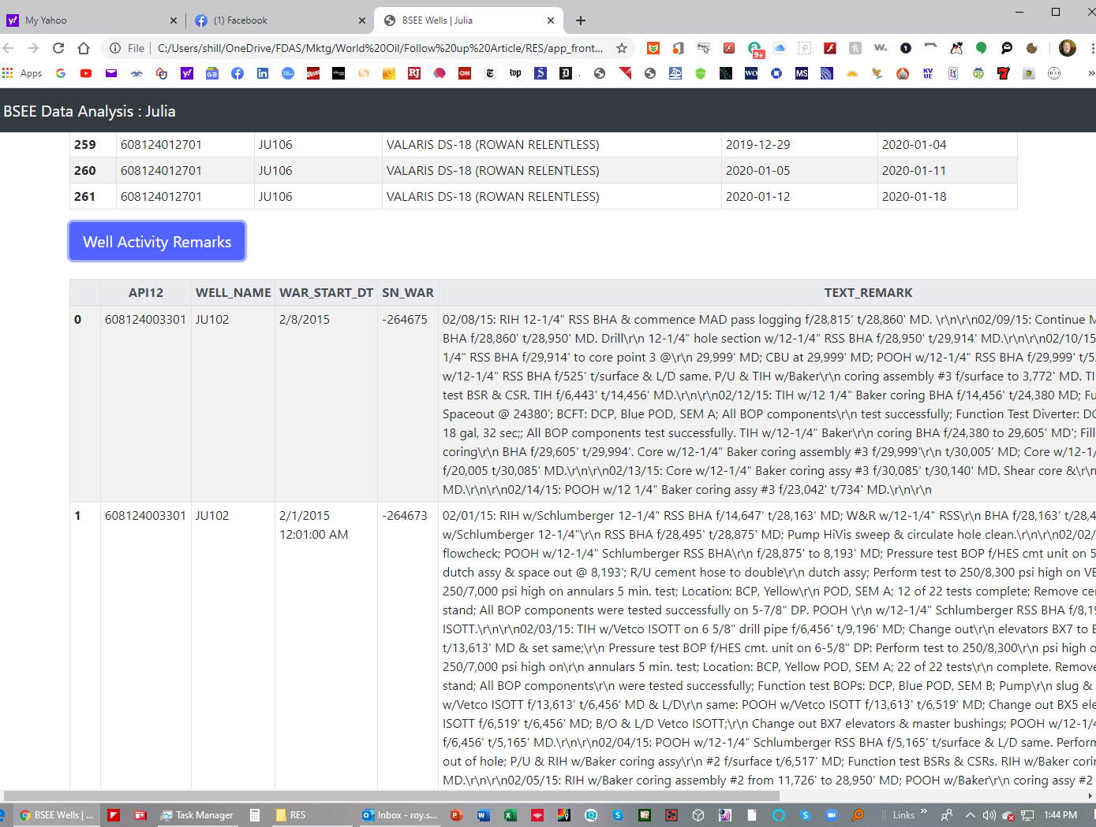
Don’t need API12 number or well name column. The user would have already selected the well so just need start date, end date and text remarks.

